Slide 1

Channel Analysis
Exploratory Data Analysis and Strategic Review of Packaged Current Accounts

Slide 2

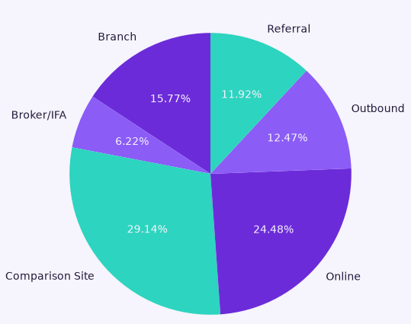
Money, Crafted Today.
How Our Customers Find Us
Budget of
£150,000 across six channels
Important Metrics:
Churn rate
Cost vs. Value
High Value Customer Index
1

Slide 3
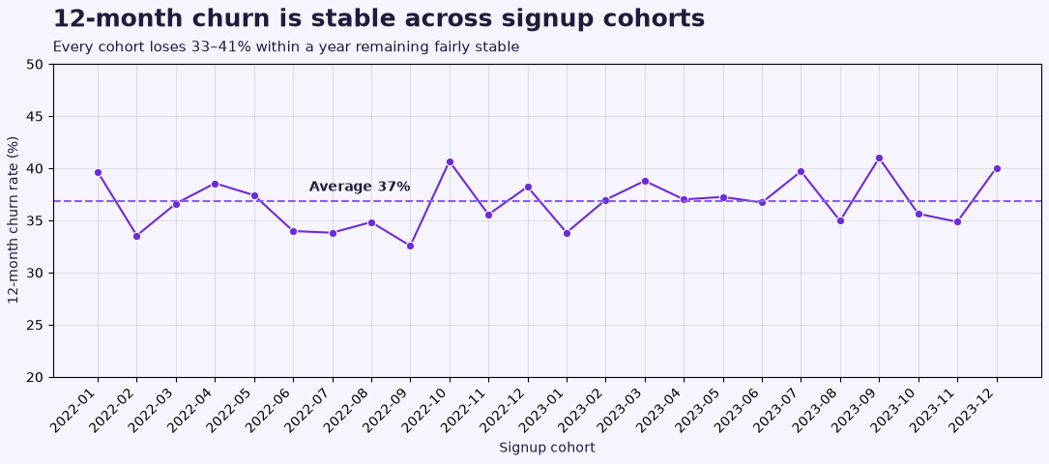
Twelve Month Churn Rate by Cohort
2

Slide 4
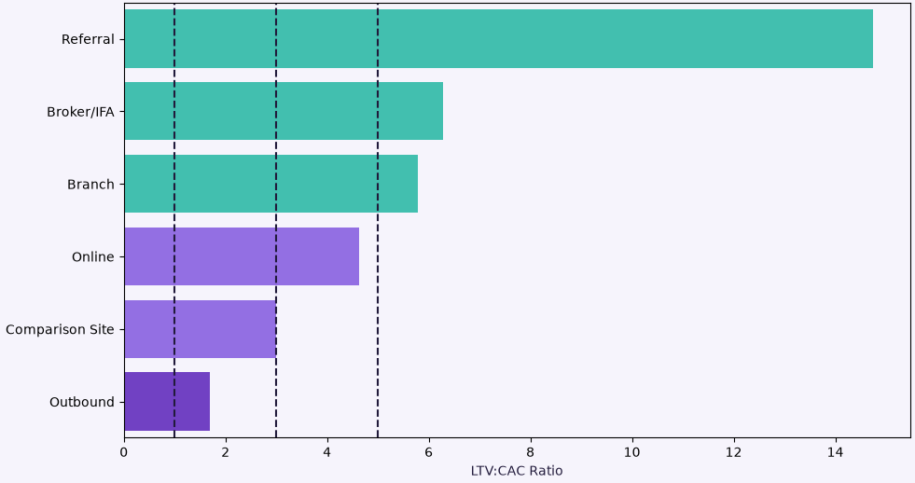
What is Each Channel Worth?
LTV:CAC Ratio by Channel
Comparing Cost vs. Value
Each customer from Referral generates around 15x more than the Acquisition cost.
Outbound only just covers its costs in comparison to the other channels.
14.74
6.28
5.78
4.63
3.00
1.70
3
Notes:
Referral ratio suggests potential under investment in growth; could spend more to scale efficiently.
Our channels are widely unequal where some channels are returning 15x the investment made to earn a customer.
Ratio < 1:1: Losing money on each customer; unsustainable growth.
Ratio ≈ 3:1: Healthy; each customer generates roughly three times the acquisition cost.
Ratio > 5:1: Potential under-investment in growth; could spend more to scale efficiently

Slide 5
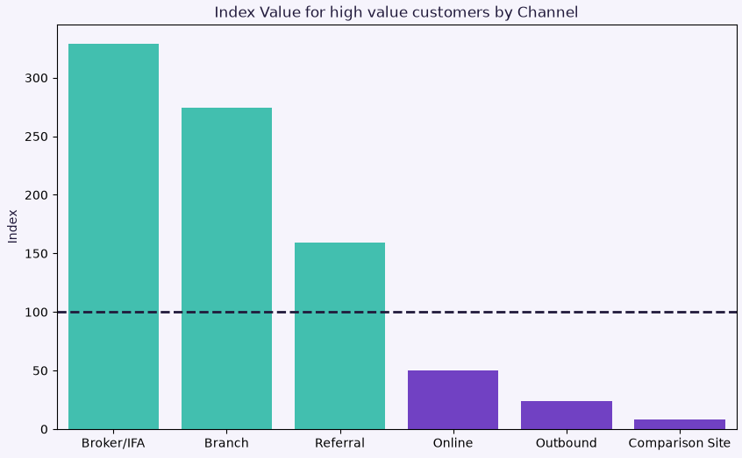
Where Are the High Value Customers?
Index Value for High Value Customers by Channel
High value customers = Top 20% of customers by Total Revenue.
High value customers are over-represented in:
Broker/IFA
Branch
Referral
High value customers are under-represented in:
Online
Outbound
Comparison Site
329
159 = A high value customer is 59% more likely to arrive to Money Craft through Referrals than a typical customer
274
159
50
24
8
4

Slide 6
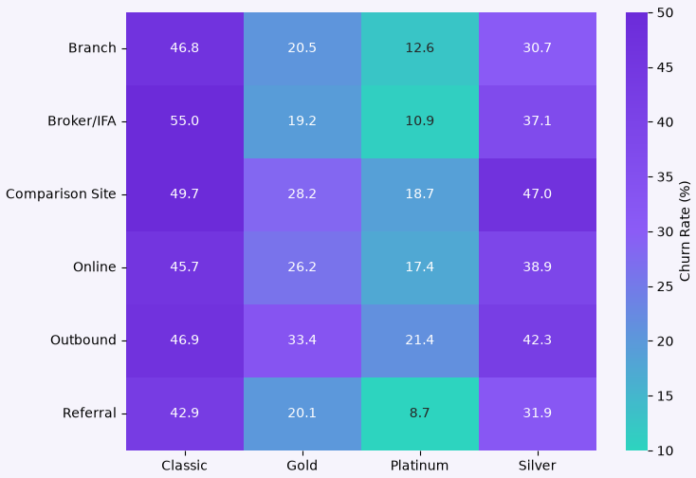
Where does Churn Come From?
Churn rate by Channel and Tier
The Referral channel contains the lowest churn rate over every tier.
Outbound has the highest churn rate in gold and platinum and high churn rates overall.
5

Slide 7
How Can We Improve Our Budget Allocation?
Referral wins!
Generates ~15x more money than the acquisition cost
Room for growth
Lower churn
High value customers are over-represented
Branch does well.
Generates ~6x more than the Acquisition cost
Low to mid churn
Good representation of high value customers
Broker/IFA, Comparison and Online trail behind.
High index for Broker/IFA is not reliable.
Comparison and Online represent a larger % of the customer base
Outbound loses!
Generates only ~1.7x more than acquisition cost.
A high churn rate over all tiers
Weak Index
7
Notes:
LTV:CAC - e.g., for referral: a typical customer from this channel generates ~15x the cost to acquire them
Referral has room for growth (11.92% of customers is a smaller proportion of the overall customer base)
Compared with other channels, referral has the lowest churn rate across all tiers of account.
Over-indexed channels have a large proportion of high value customers (80th percentile for revenue generated)

Slide 8
Channel | Budget from last Quarter | New Budget Suggestion | Change
Referral | £13,122 | £32,262 | + £19,140
Branch | £41,027 | £45,000 | + £3,973
Broker/IFA | £19,791 | £19,791 | No change
Online | £31,121 | £31,121 | No change
Comparison Site | £21,826 | £21,826 | No change
Outbound | £30,365 | £0 | - £30,365 Cut
8

Slide 9
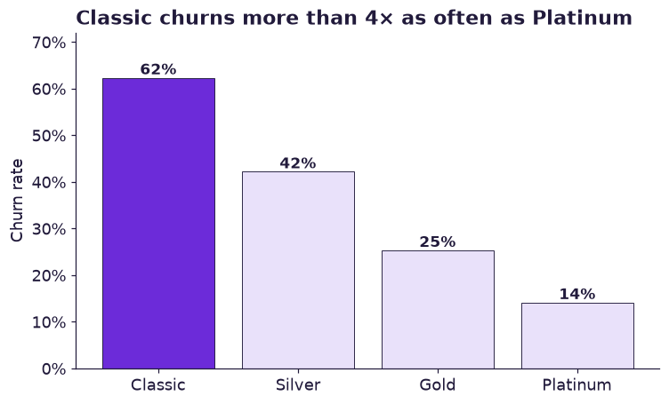
Supplementary Slides:

Slide 10
Channel | Customers | Percentage | LTV:CAC | Index
Referral | 1,875 | 11.9 | 14.74 | 159
Broker/IFA | 979 | 6.2 | 6.28 | 329
Branch | 2,481 | 15.8 | 5.78 | 274
Online | 3,851 | 24.5 | 4.63 | 50
Comparison Site | 4,584 | 29.1 | 3.00 | 8
Outbound | 1,962 | 12.5 | 1.70 | 24
9
Notes:
Room for growth (11.9%)

Slide 11
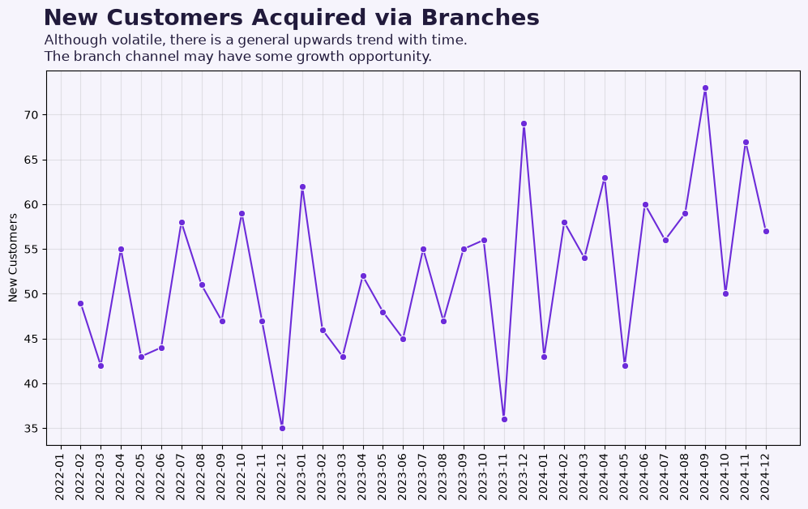

Slide 12
What Are Our Assumptions?
Churn rate - Our LTV rests on the rate at which customers leave, which we assumed stays constant over their life.
High Value Customers - defined as the customers in the top 20% of total revenue.
“Unknown” and “No record at all” - were treated as the same thing
Fairness - 12 months minimum activity was verified to ensure fairness when comparing 12 month churn for different channels
6

